Slide 1
COVID-19: PREDICTION OF THE HOSPITALIZATION RATE
Statistisches Praktikum
WiSe21/22
16.03.2022
Munich
Group:
Alexander Marquard
Phu Nguyen
Qian Feng
Project partner:
Yeganeh Khazaei
Statistisches Beratungslabor StaBLab der LMU
Institut für Statistik

Slide 2
AGENDA
01
02
Background Information
Data Processing
Data Analysis
03
04
Model Introduction
Discussion
05
2

Slide 3
01
BACKGROUND INFORMATION
3

Slide 4
BACKGROUND INFORMATION
Background:
Meaningful evaluations of the data base and determination of measures (such as the reproduction number, incidence, or hospitalization incidence) serve as guiding criteria for measures against the further spread of the virus.
Task at hand:
Predict hospitalization rate one to two weeks in the future, taking into account both time and geographical factors.
4

Slide 5
DEFINITIONS
HOSPITALIZATION (RATE)
The number of COVID-19 patients admitted for treatment (per 100,000 population) in a given time period.
formula

Slide 6
DEFINITIONS
NOWCASTING
Problem: Delays in reporting (period between onset of illness and reporting).
New hospitalizations being reported daily do not reflect actual numbers
Nowcast: An estimate is provided at the current point in time by using a statistical procedure

Slide 7

DEFINITIONS
DELAYED REPORTS
 | Reported | Updated
01.08.2021 | 407 | 756
02.08.2021 | 416 | 786
407
416
Notes:
6.5

Slide 8
TYPICAL COVID-19 PROGRESSION
Latency period (non-contagious): Ø 2.5 Days
Ø 4 Days
04
Incubation period: Ø 5 – 6 Days
First symptoms
Hospitalization of a severe case
Infected
Contagious
5

Slide 9
BUREAUCRATIC REPORTING PROCESS OF A COVID-19 CASE
Reported at the local health department
First symptoms
Reported at the RKI
Hospitalization of a severe case
Tested positive
Reported date
Hospitalized date
5

Slide 10
WHAT IS ACTUALLY PREDICTED THEN?
The updated hospitalization rate
on the reported date of infection
for the next two weeks
4

Slide 11
02
DATA PROCESSING

Slide 12
DATA COLLECTION
From the RKI:
Neuerkrankung
Hospitalisierung
From the KITMetricslab:
Population
Data on the COVID-19 vaccination rate
Conflicts with other data sets:
Age groups on the Impfquote data set:
„05-11“, „12-17“, „18-59“, „60+“
Age groups on the Neuerkrankung and Hospitalisierung data sets :
„00-04“, „05-14“, „15-34“, „35-59“, „60-79“, „80+“
4

Slide 13
FINALIZED DATA SET
Meldedatum | Kalenderjahr | Kalenderwoche | Index | Bundesland | Altersgruppe | Population | Neuerkrankung | Hospitalisierung
2020-03-01 | 2020 | 9 | 9 | Bayern | 80+ | 871866 | 0 | 0
2020-03-08 | 2020 | 10 | 10 | Bayern | 80+ | 871866 | 3 | 2
2020-03-15 | 2020 | 11 | 11 | Bayern | 80+ | 871866 | 39 | 25
2020-03-22 | 2020 | 12 | 12 | Bayern | 80+ | 871866 | 214 | 132
2020-03-29 | 2020 | 13 | 13 | Bayern | 80+ | 871866 | 759 | 383
7

Slide 14
03
DATA ANALYSIS

Slide 15


PROBLEMS
Berlin
Brandenburg
4

Slide 16
PROBLEMS
 | Neuerkrankung | Hospitalisierung
Berlin | 1 | 0
Brandenburg | 0 | 1
4

Slide 17
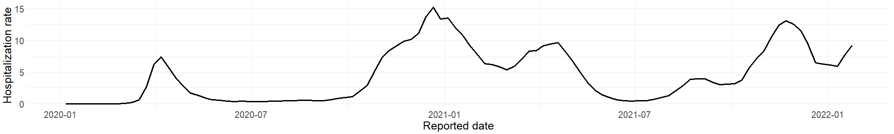
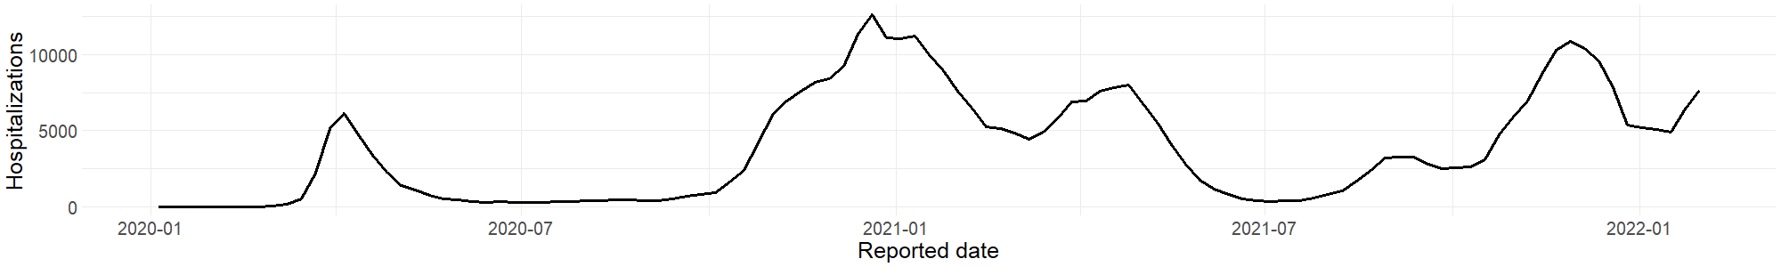
POSSIBLE INTERPRETATIONS OF „HOSPITALIZATION RATE“
Standard
Absolute numbers
13
Notes:
Standard

Slide 18
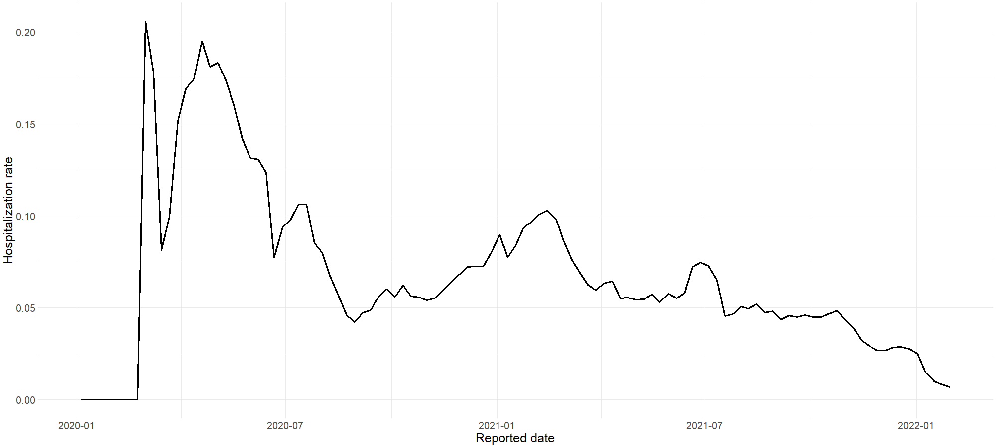
POSSIBLE INTERPRETATIONS OF „HOSPITALIZATION RATE“
Hospitalizations / Infected
13
Notes:
Standard

Slide 19
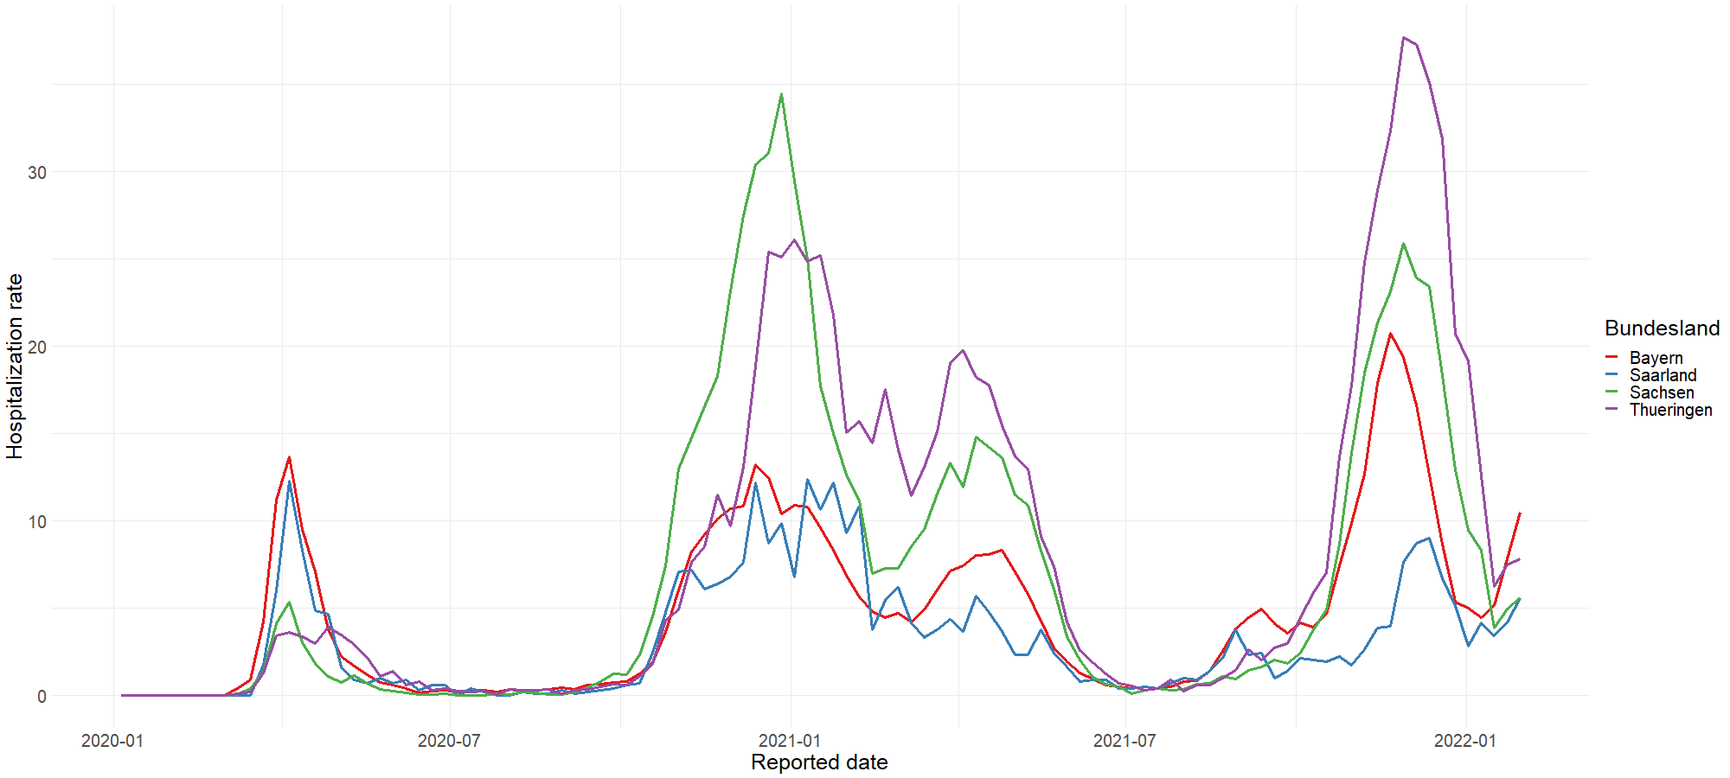
HOSPITALIZATION RATE BY STATE
13

Slide 20
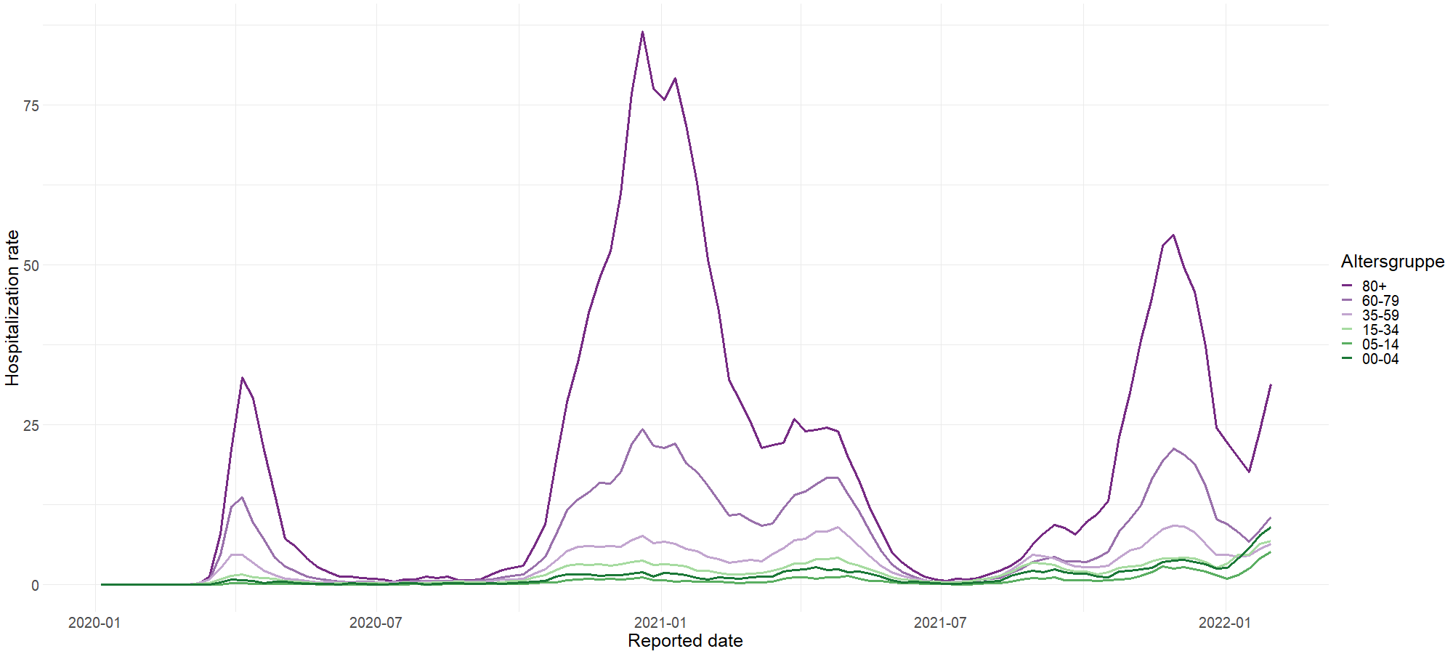
HOSPITALIZATION RATE BY AGE GROUP
13

Slide 21
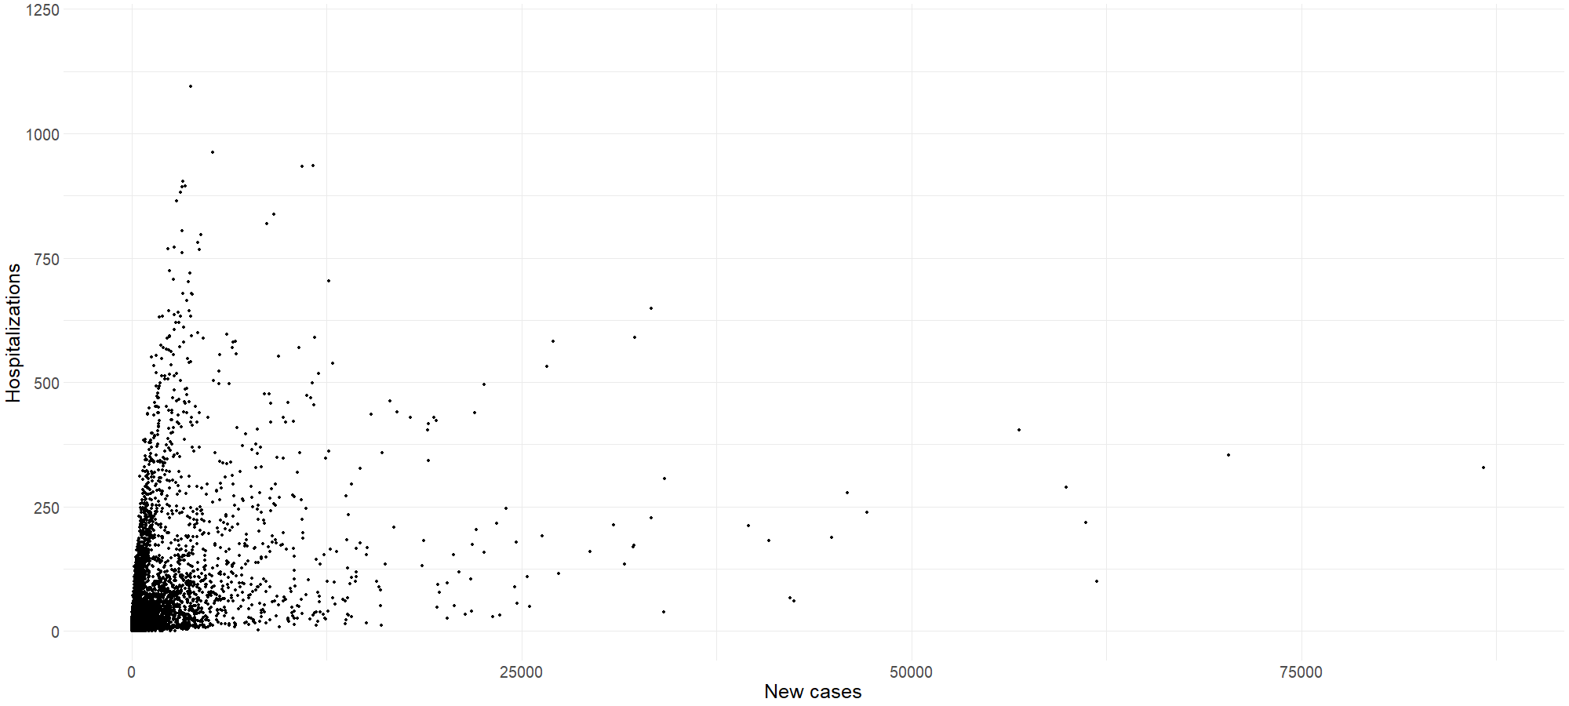
HOSPITALIZATIONS VS. NEW CASES
13

Slide 22
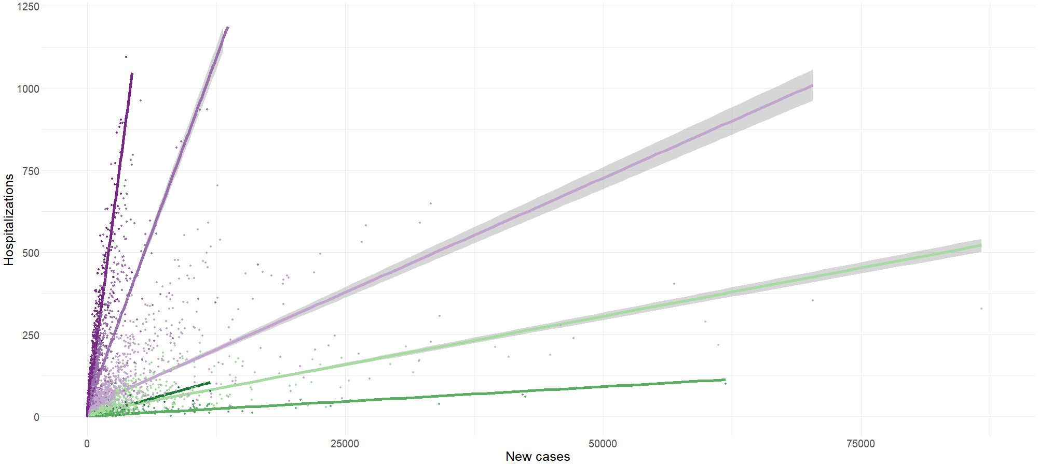

HOSPITALIZATIONS VS. NEW CASES
13

Slide 23
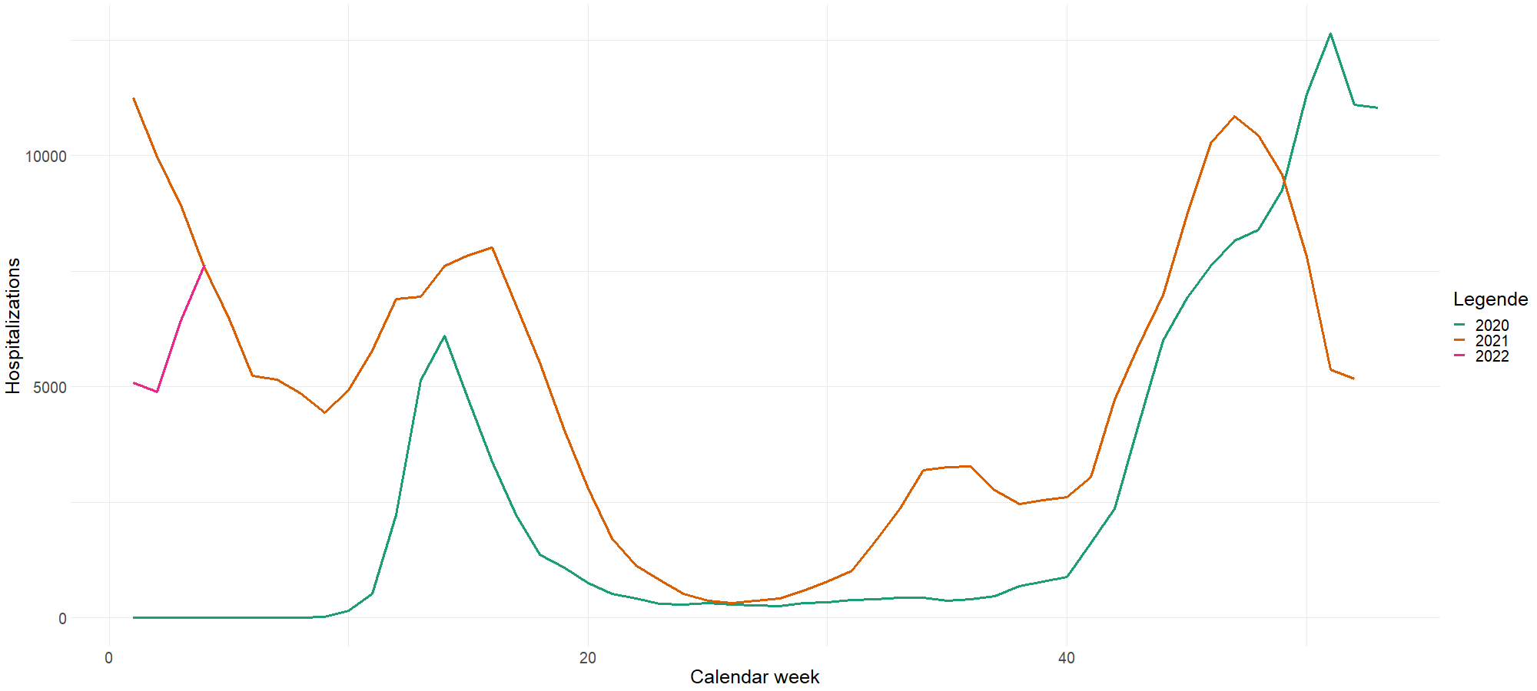
SEASONAL EFFECT
13

Slide 24
04
MODEL INTRODUCTION

Slide 25
MODELLVORSTELLUNG (FÜR BAYERN)
log(Hospitalisiert)_{i} = β₀ + β₁ * Ⅰ(Altersgruppe_{i} = "60+") +
β₂ * Ⅰ(season_{i} = "Autumn") +
β₃ * Ⅰ(season_{i} = "Spring") +
β₄ * Ⅰ(season_{i} = "Winter") +
β₅ * log(Neuerkrankte_lag1)_{i} +
β₆ * log(Neuerkrankte_lag2)_{i} + ε_{i}
Multiple R-squared: 0.9512 Adjusted R-squared: 0.9495
15
Notes:
Coefficients: Estimate Std. Error t value Pr(>|t|) (Intercept) -1.83770 0.15982 -11.499 < 2e-16 *** Altersgruppe(59, Inf) 1.66400 0.06008 27.698 < 2e-16 *** seasonAutumn -0.11828 0.08151 -1.451 0.14855 seasonSpring 0.23664 0.08079 2.929 0.00387 ** seasonWinter 0.09325 0.10207 0.914 0.36223 log(lag_1) 1.37197 0.05791 23.692 < 2e-16 *** log(lag_2) -0.57622 0.05312 -10.847 < 2e-16 ***

Slide 26
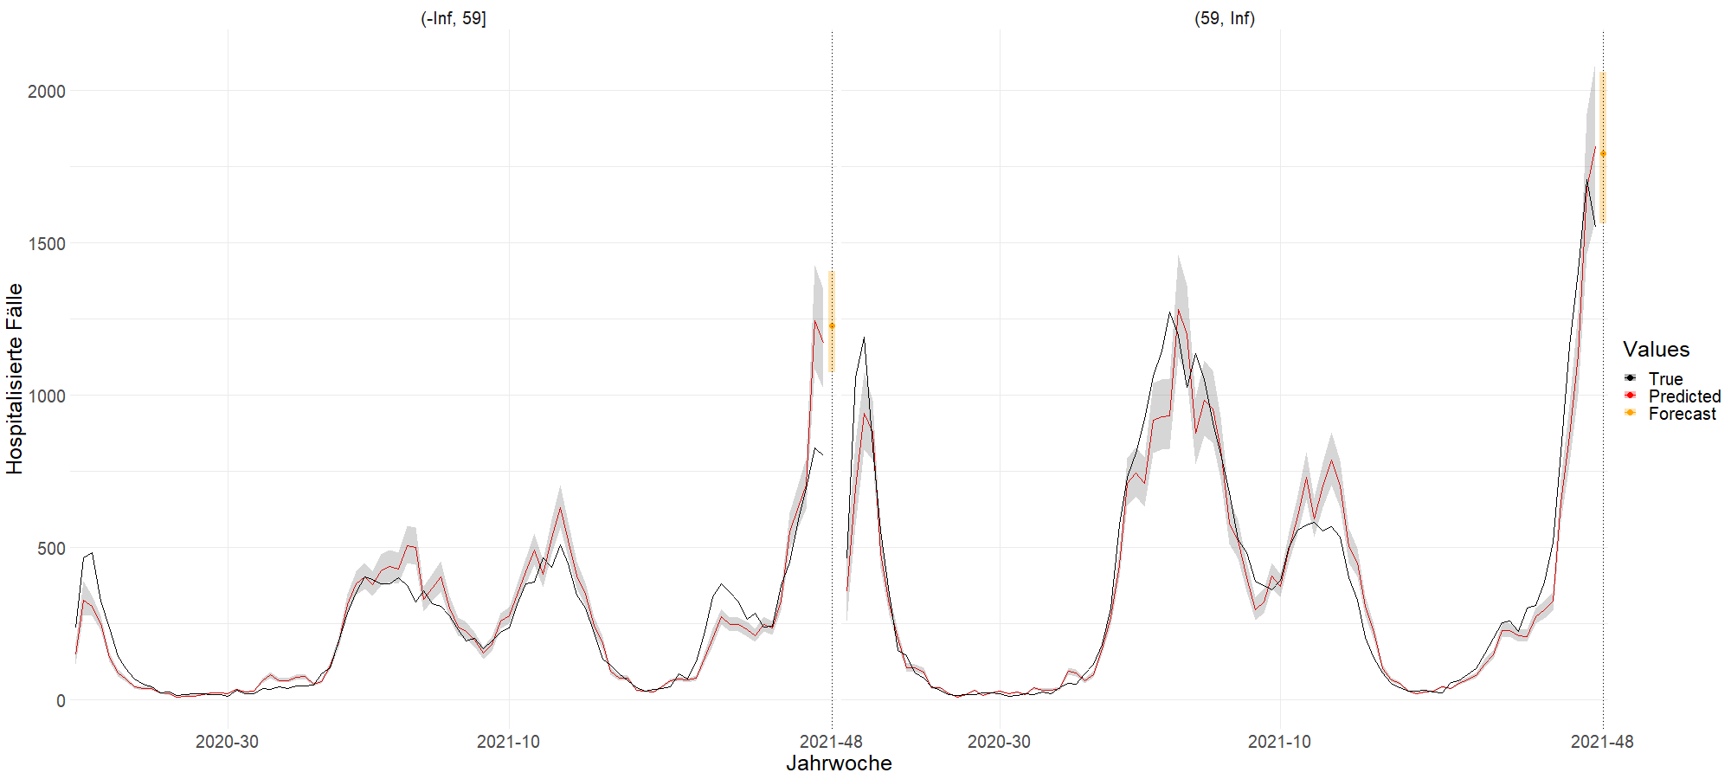
PREDICTION GRAPH (FÜR BAYERN)
16

Slide 27
AUSBLICK
Infektion aufteilen in geimpft und ungeimpft
Tiefergehende Datenanalyse bzgl. Interaktionseffekten und weiterer Kovariablen
Testen von GAM
Diagnose des aktuellen Modells
17

Slide 28
Diskussionsrunde
05

Slide 29
ANHANG
19

Slide 30
Beta Koeffizienten
Coefficients:
Estimate Pr(>|t|)
(Intercept) -1.83770 < 2e-16 ***
Altersgruppe(60+) 1.66400 < 2e-16 ***
seasonAutumn -0.11828 0.14855
seasonSpring 0.23664 0.00387 **
seasonWinter 0.09325 0.36223
log(Neuerkrankte_lag_1) 1.37197 < 2e-16 ***
log(Neuerkrankte_lag_2) -0.57622 < 2e-16 ***
20

Slide 31
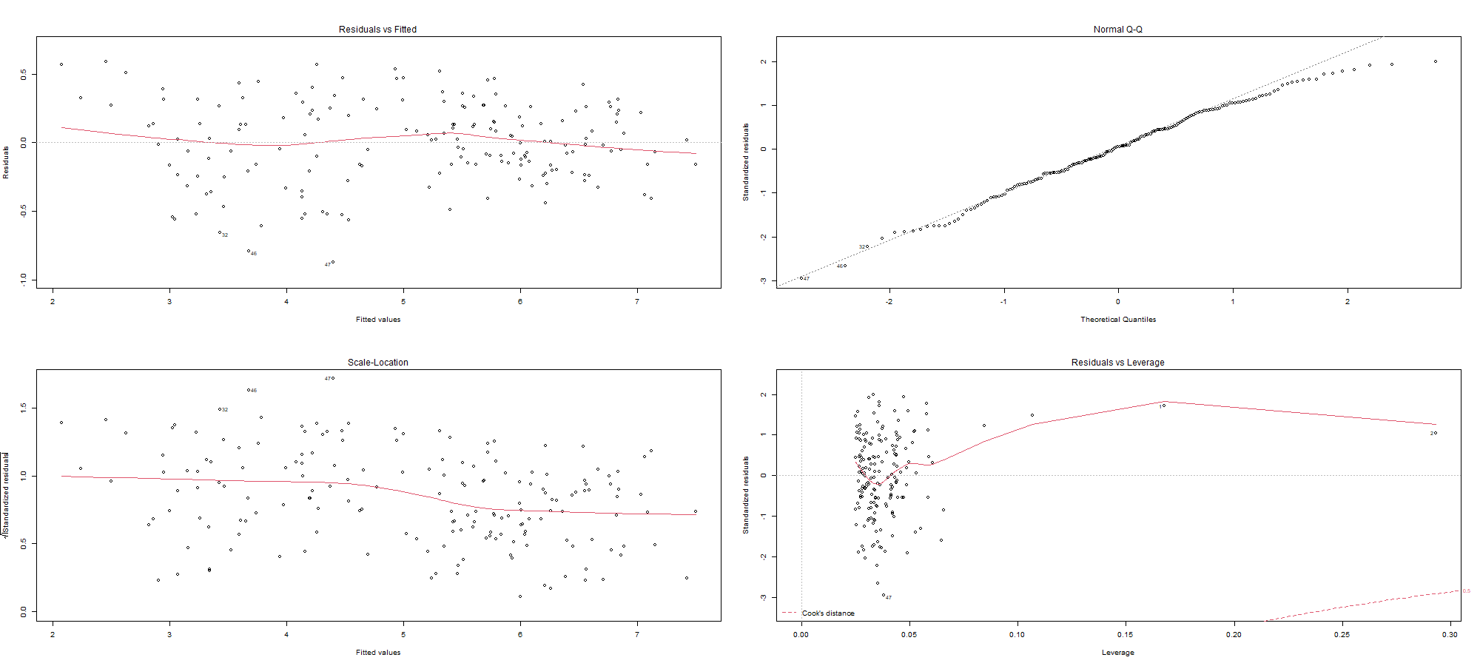
DIAGNOSEPLOTS
21

Slide 32
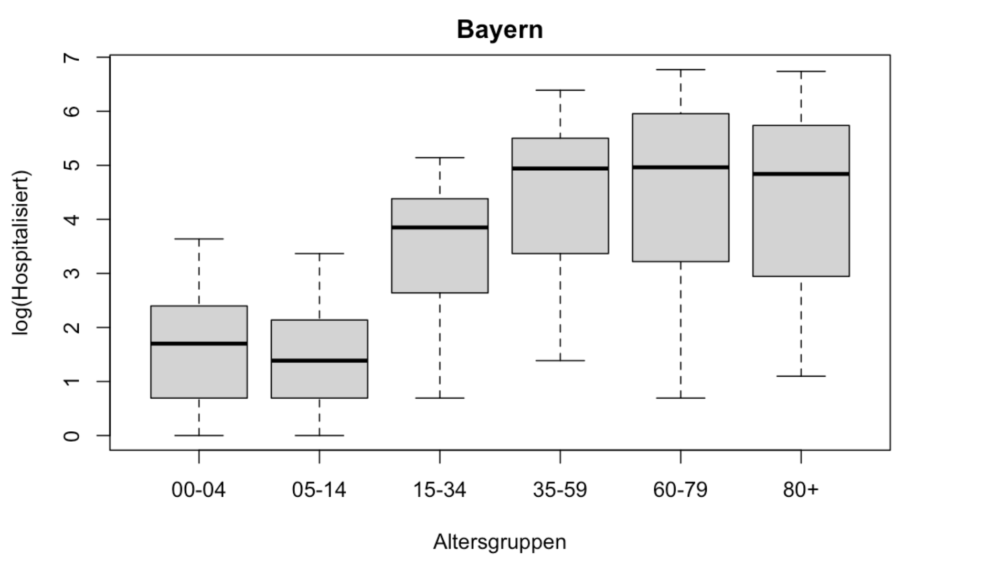
22

Slide 33
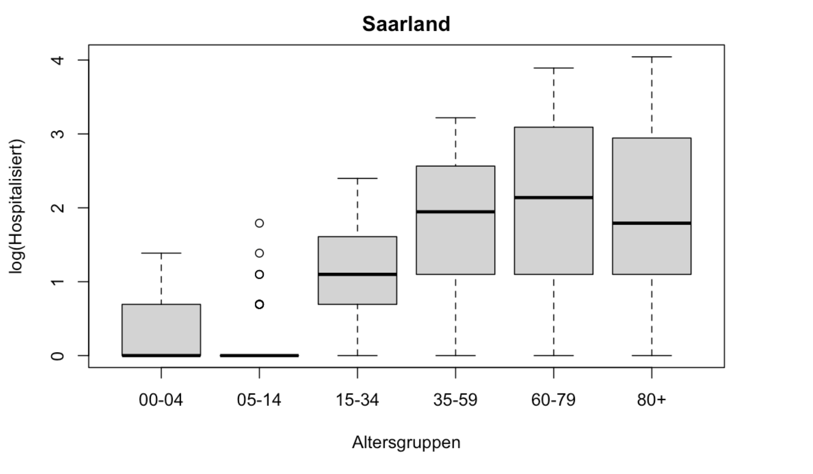
23

Slide 34
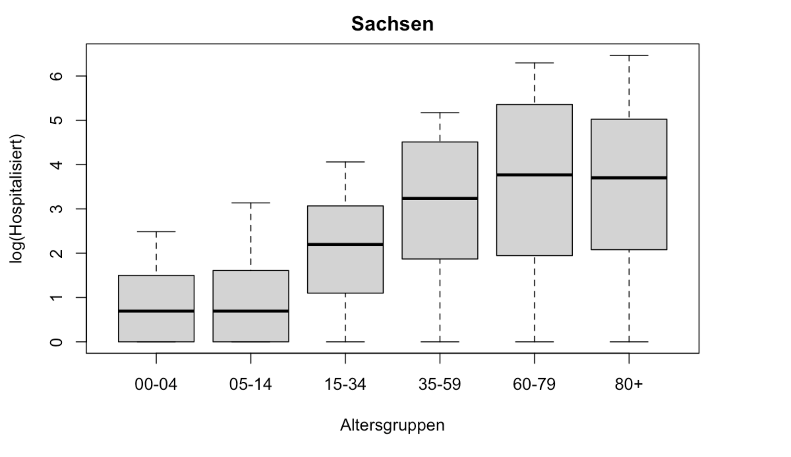
24

Slide 35
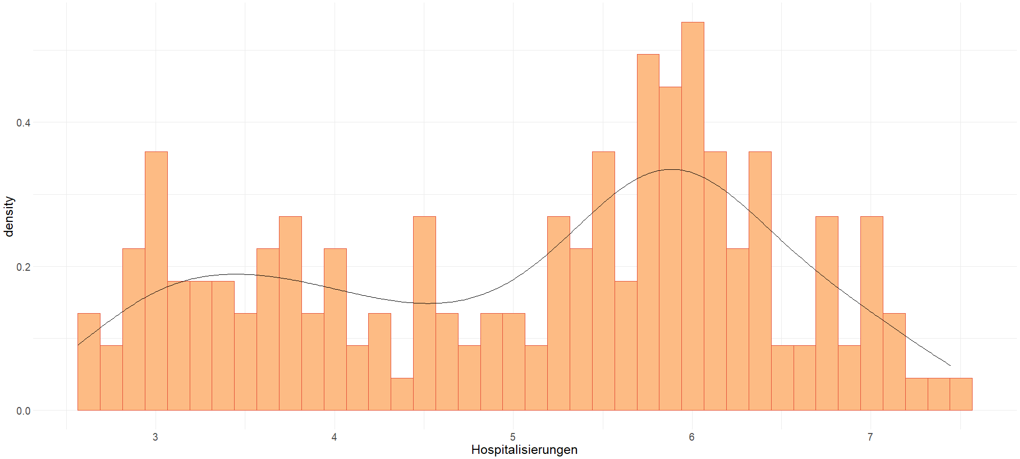
VERTEILUNG HOSPITALISIERUNG INNERHALB EINER WOCHE
25

Slide 36
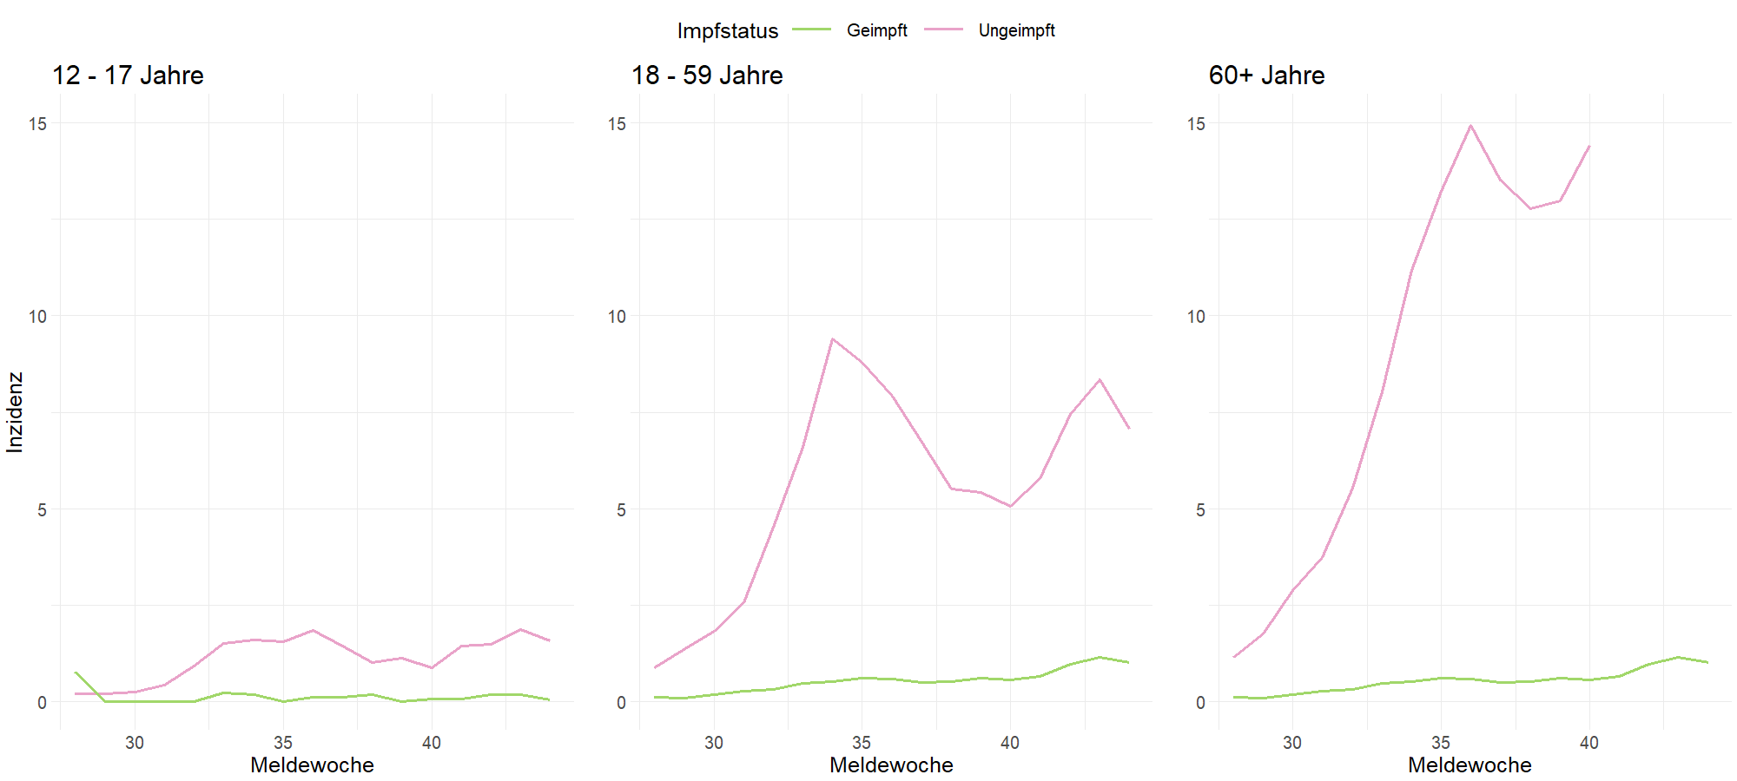
HOSPITALISIERUNGSINZIDENZ NACH ALTERSGRUPPEN UND IMPFSTATUS
26

Slide 37
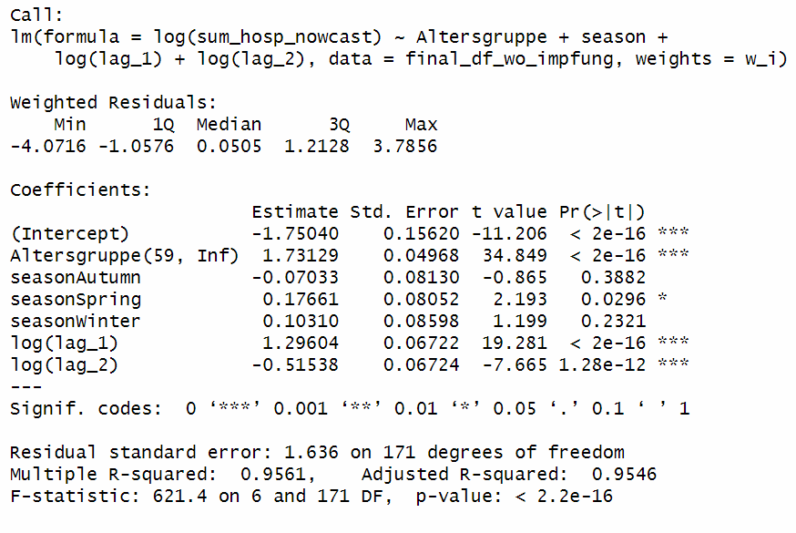
27

